Slide 1

Arduino – Day2
BIOE 3090

Slide 2

Activity 3 – Simplify the Main Loop
From Last Time

Slide 3
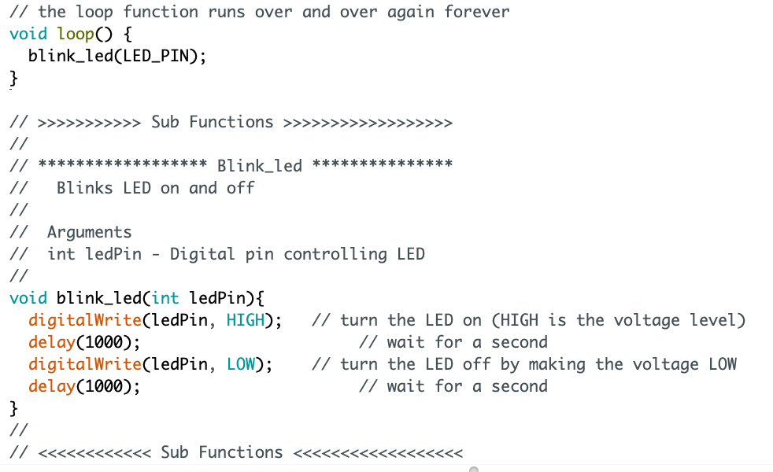
Functionalized Programming
Simplified main loop
Begin
Pin Definitions
Setup
Loop
blink_led()

Slide 4
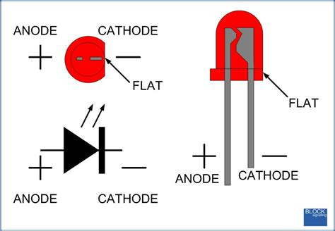
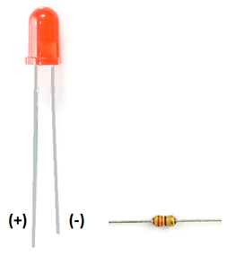
Wiring LED
Cathode

Slide 5
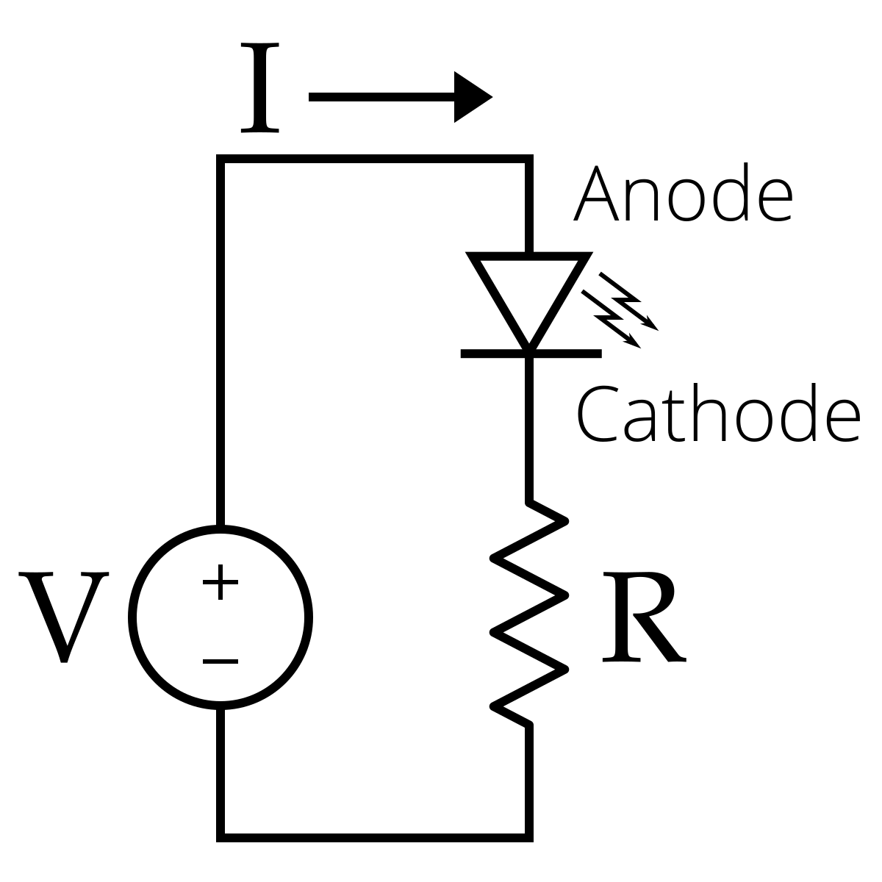
Wiring LED
For LED
1.8-2.2VDC forward drop
Max current: 20mA
Suggested using current: 16-18mA
Luminous Intensity: 150-200mcd
V=IR
R=(5V-2.2V)/.017A
R=165 Ohm

Slide 6
Activity 4– Make LED Blink on Breadboard

Slide 7
Microcontroller Timing
delay(1000) stops program execution and waits. BAD!!!

Slide 8
Microcontroller Timing
BAD delay, make better!
How?

Slide 9
Microcontroller Timing
BAD delay, make better!
Function called at specified time interval.

Slide 10
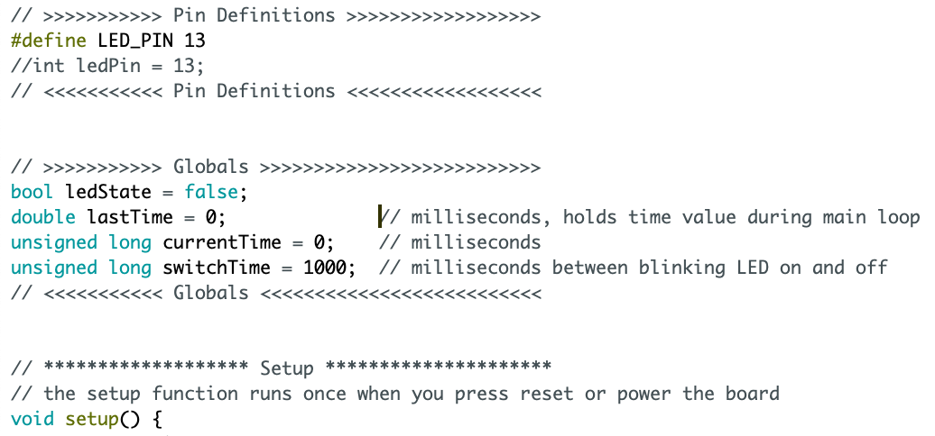
Globals
Timing variables

Slide 11
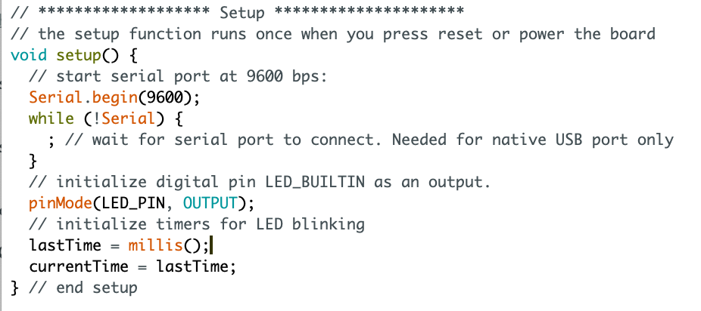
Set Globals in Setup

Slide 12
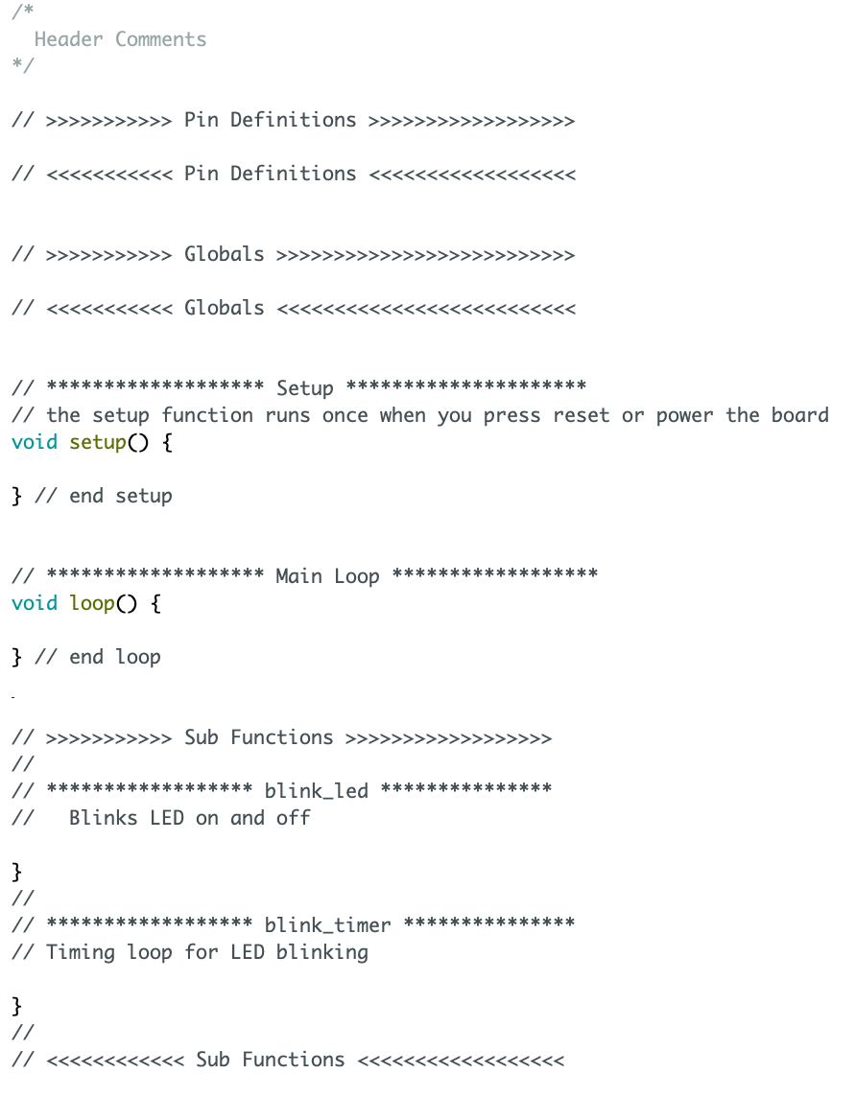
Begin
Pin Definitions
Setup
Loop
Blink_timer()
N
If
Y
blink_led()
Elapsed Time > Switch Time

Slide 13
Activity 5 – Blink_3090 – no delay
Using
currentTime
lastTime
switchTime
ledState
Millis()
Create
Delay()-free timing in main loop
Blink LED

Slide 14
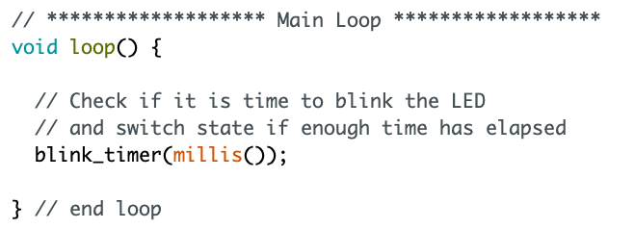
Main Loop
Timing function
Get the current
time & pass to function
blink_timer( millis() )

Slide 15
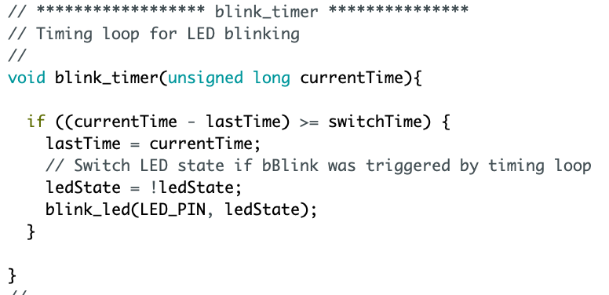
Main Loop
Check if it is time to
blink

Slide 16
Main Loop
Check if it is time to
blink
Flip Bool State

Slide 17
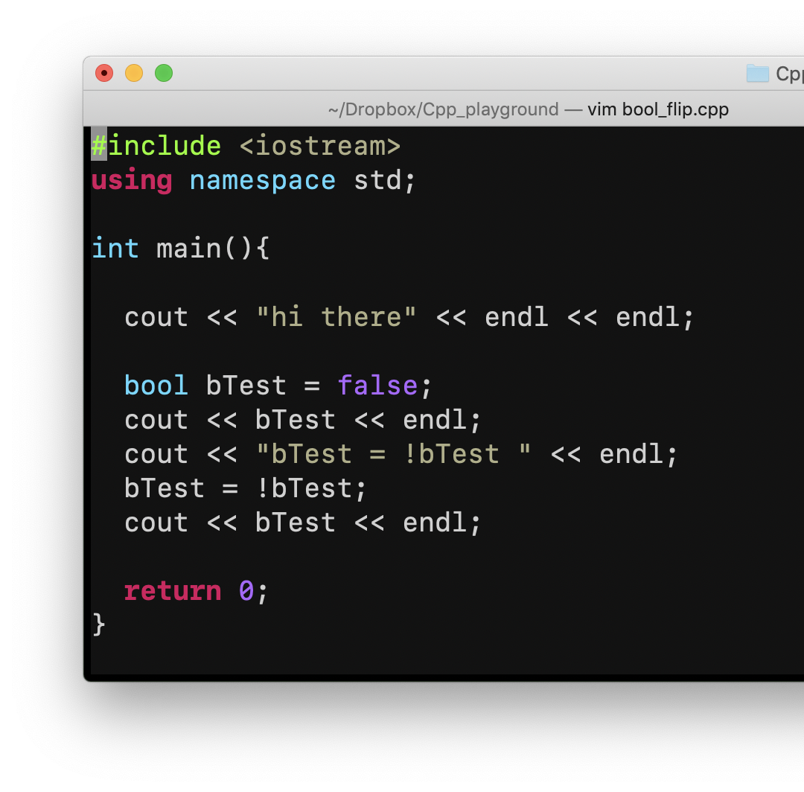
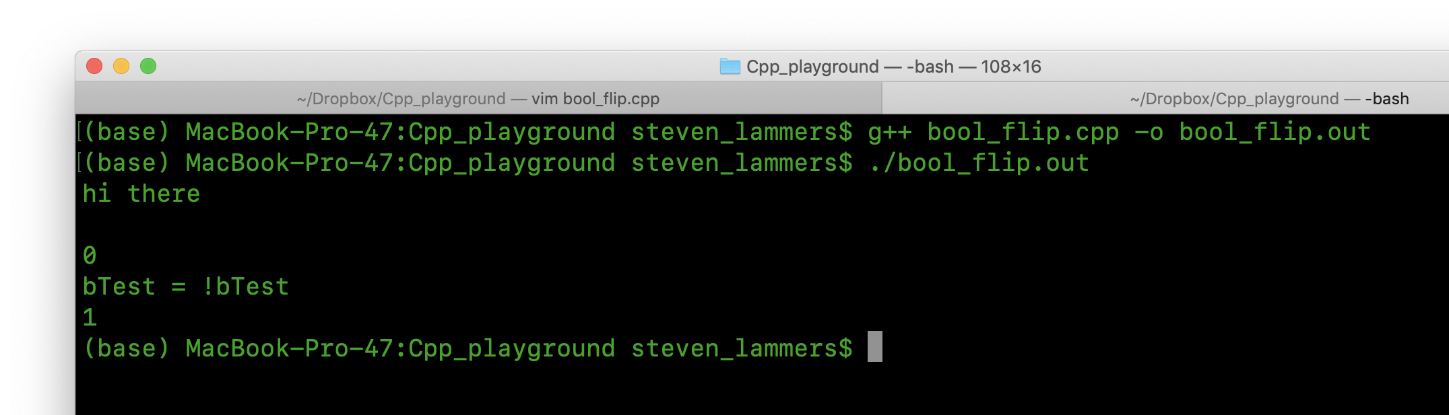
ANSIC Flip Boolean

Slide 18
Main Loop
Important problem
here
Notes:
Millis Rollover

Slide 19
In-Class Design - DCW User Story to User Needs
Translate User Story into User Needs
Translate User Needs into Requirements
This can be tricky!

Slide 20
Writing Requirements
Requirements need to:
Specify a single, unique feature
Written using appropriate auxiliary verbs and language
Testable with corresponding verification test
Testable with a binary pass/fail condition
Should not include / define a solution

Slide 21
Requirements with Problems
The cost / budget shall not exceed
The bioreactor shall notify the user via LED…
The bioreactor shall have transducers that measure internal pressure.
The system shall monitor the pressure of the atmosphere within the bioreactor in MPa.
The system shall transduce a signal from the force applied to the sample by a cyclic piston.

